Slide 1
Photography
My two cents… Shashank Singh

Slide 2
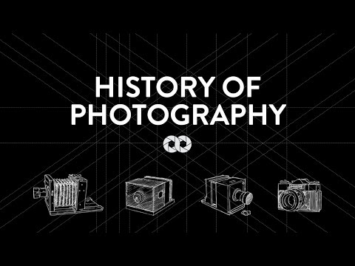
History

Slide 3
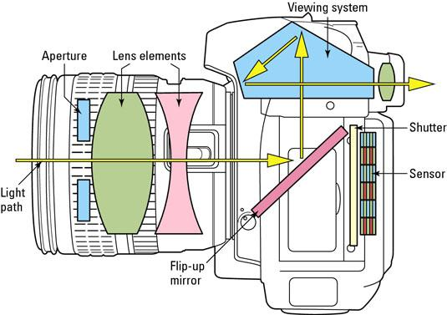
Internals
http://forum.digit.in/cameras-camcorders/155823-dslr-technical-guide.html

Slide 4
MegaPixel myth
Images are not just about Megapixels.
Pixels per Inch of sensor
Sensor quality
Light sensitivity
Lenses and light
3MP is enough for a decent sized print. 8MP cameras on cellphones are more than enough for HD photos

Slide 5
Shutter Speed
When would you want to increase shutter speed?
What about decreasing?
Shutter speed is usually given in terms of seconds. 1/125 shutter speed means your shutter exposed light to the sensor for 1/125th of a second. You can extend exposure to 30 seconds with manual mode!

Slide 6
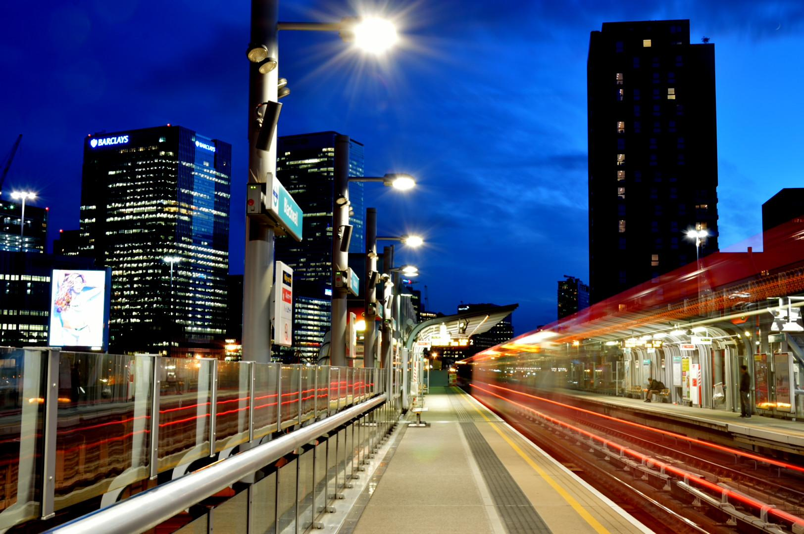
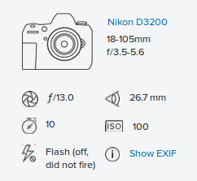

Slide 7
Apperture
How big do you want the pinhole to be?
Inversely proportional to the ‘f’ number you see in cameras. f stop = geometric ratio of halving light intensity
f4 ≅ big pinhole ≅ more light/exposure and depth of vision (blurring of background) effect
f16 ≅ smaller pinhole ≅ less exposure and more sharp/focused throughout

Slide 8
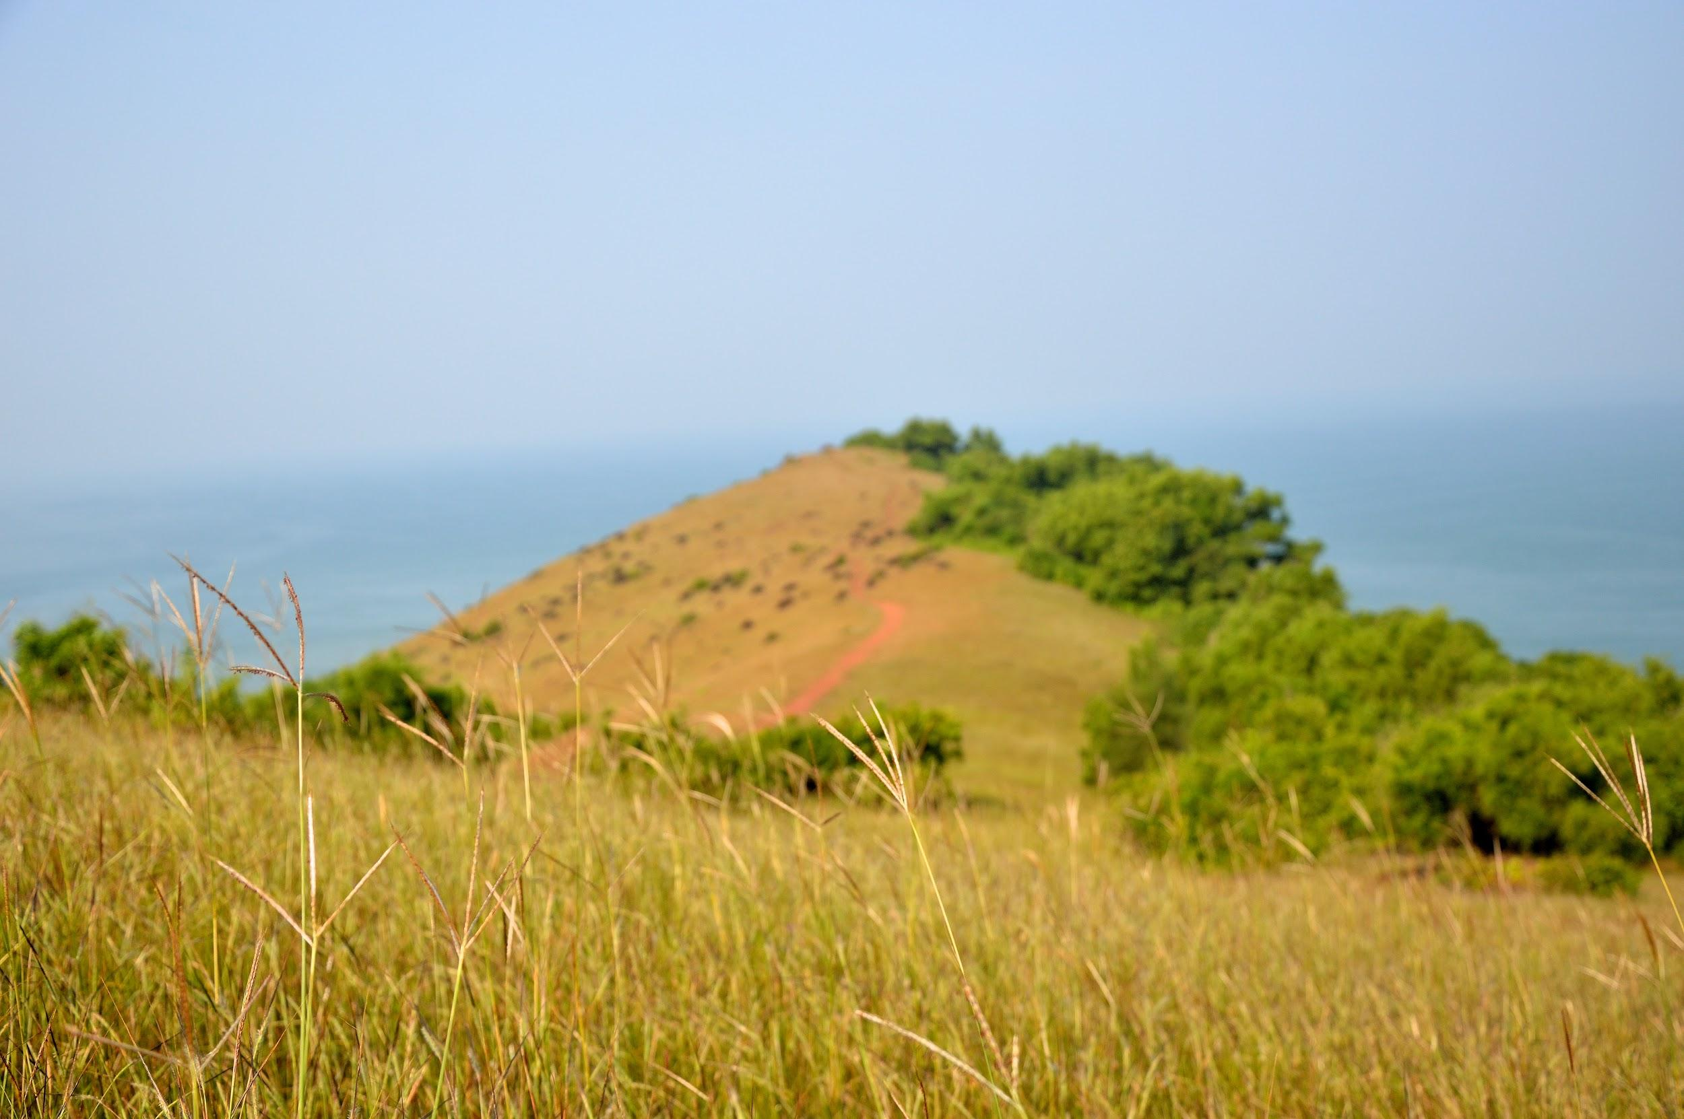
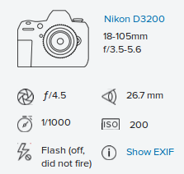

Slide 9
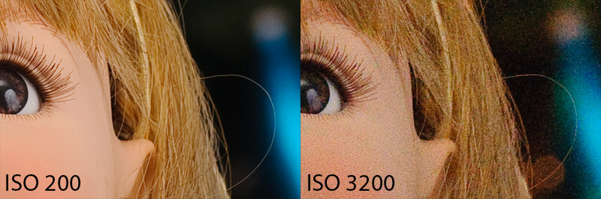
ISO
Light sensitivity
Try to stick to lowest ISO possible for less noise. However, increase it in low light conditions as needed

Slide 10
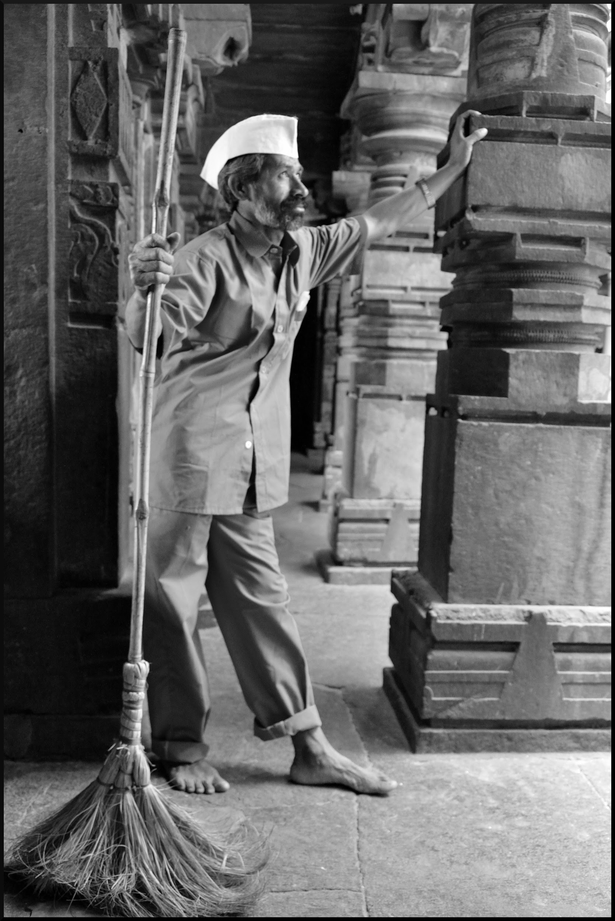
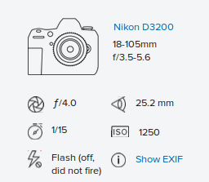

Slide 11
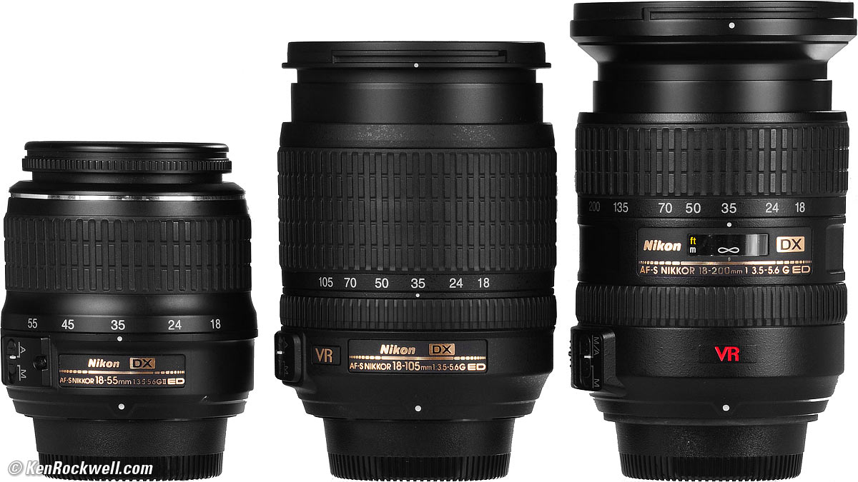
Focal Length
What lens do you have? 18mm - 105mm
What do those terms mean?
Standard(18 - 55)
Prime (fixed)
Telephoto (70-300mm)
Wide Angle (under 50mm)

Slide 12
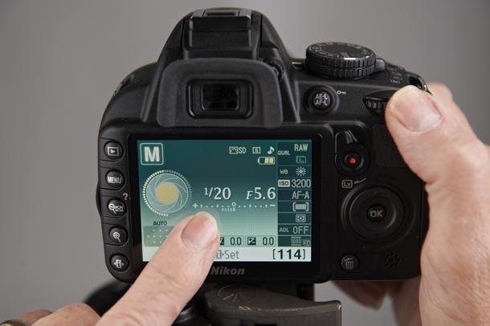
manual mode

Slide 13
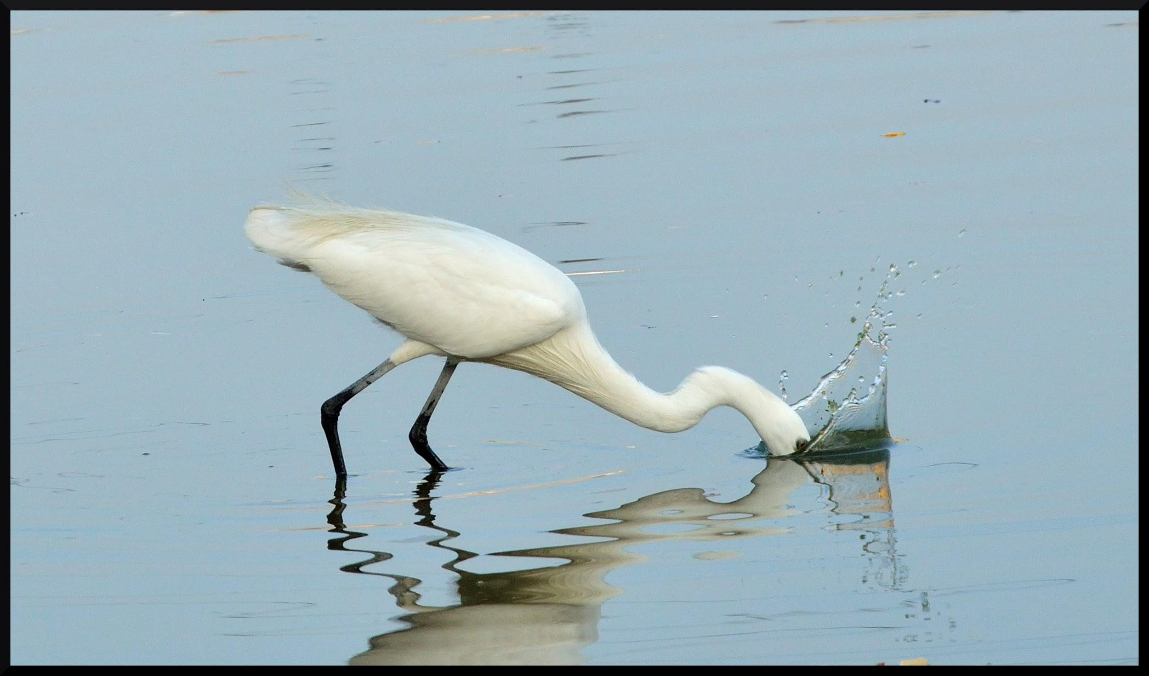
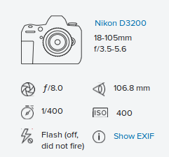
Sports mode (3-4 clicks per second)

Slide 14
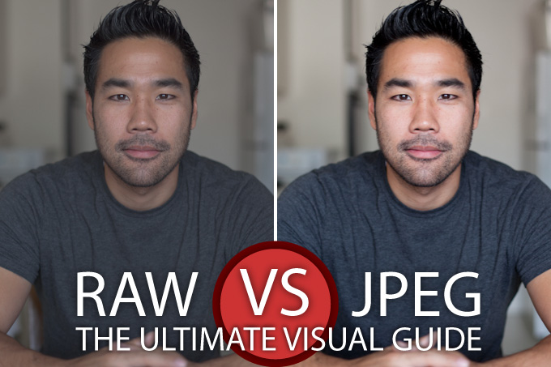
RAw and Post-Processing
https://www.slrlounge.com/school/raw-vs-jpeg-jpg-the-ultimate-visual-guide/

Slide 15
What if I don’t have an SLR camera?
https://www.flickr.com/photos/shashanksingh/19690362966/in/album-72157655453314179/
https://www.flickr.com/photos/shashanksingh/5498889915/in/album-72157626075072929/

Slide 16
Tips
Avoid flash as much as possible (unless you really know what you are doing). It spoils natural lights and ambience. Try reducing shutter speed, increasing aperture and increasing iso first.
Trial and error is the best teacher.
Look for candid moments to make photographs look natural.
Travel, travel, and travel more....
Natgeo and Flickr are good sources of inspiration

Slide 17
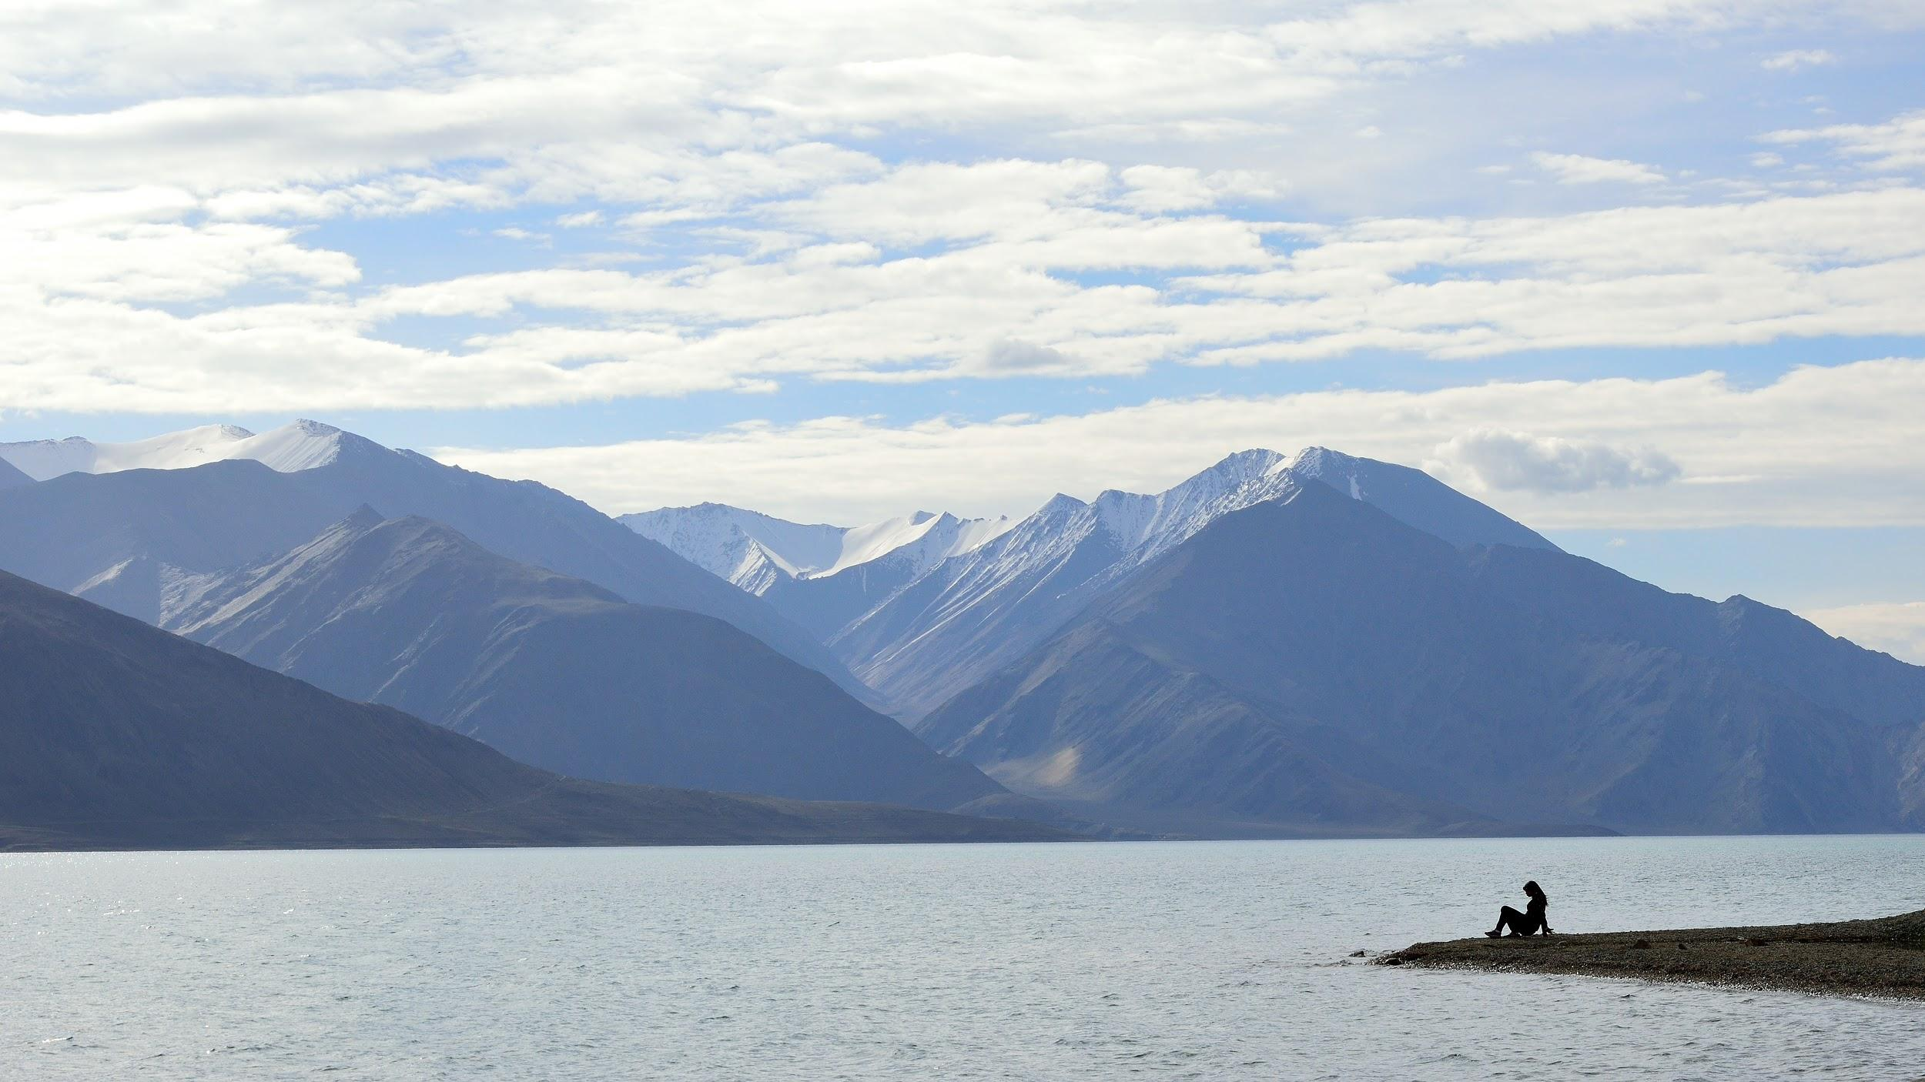

Slide 18
some more tips
Be patient. Sometimes you might have to wait for a few minutes in anticipation.
Think about memory and battery requirements.
Get a tripod if you really want to do night photography. Its worth the investment :)
Apparatus are expensive. Don’t buy a lot if you are just starting. Get a hang of your interests and start with an entry level DSLR. Nikon / Canon: both are almost equally good for a start.

Slide 19
Future?
https://www.youtube.com/watch?v=3wbvpOIIBQA
https://www.youtube.com/watch?v=4vGcH0Bk3hg

